Slide 1
Association between Use of Beta-Blockers and Mortality in Patients with Heart Failure and Preserved Ejection Fraction
a Prospective Propensity Score-Matched Cohort Study
Lars H Lund, Lina Benson, Ulf Dahlström, Magnus Edner, Leif Friberg
on behalf of the Swedish Heart Failure Registry
Conflicts of interest:
Research funding, speaker’s fees, consultancies:
AstraZeneca
Novartis
Boston Scientific
Notes:
10 min talk
5 min discussion chairpersons (Roger Hall, Bernard Iung) and discussants (Anne Demereux, Sarah Clarke)

Slide 2
Background
Heart Failure with Preserved Ejection Fraction – HFpEF
As common and possibly as lethal as
HF with reduced EF - HFrEF
Catecholamine activation
β-blockers→
reduce blood pressure, LVH, diastolic dysfunction
But few clinical studies and conflicting outcomes
Notes:
Heart Failure with preserved …

Slide 3
Background
Hypothesis:
β-blockers are associated with
Primary outcome:
Reduced all-cause mortality
Secondary outcome:
Reduced combined all-cause mortality or HF hospitalization
- in a broad un-selected HFpEF population
Notes:
Thefore we put forth the following hypothesis: ……

Slide 4
Methods
The Swedish Heart Failure Registry
Inclusion criteria: clinician-judged HF
Exlusion criteria: opt-out
Notes:
All patients with a diagnosis of Heart Failure (physician based di admitted to hospital or outpatient clinics are included in the registry. The information recorded from each patient consists of a minimum of 63 carefully selected and pre-defined variables to be filled in either by a nurse or by discharging physician. The registry cover background factors such as age, gender, marital status, living conditions, previous diseases, performed procedures as well as other investigations, selected laboratory values, medical treatment and follow-up. Data can also be imported from computer-based documentations.

Slide 5
Methods
Swedish HF Registry:
Demographics
Clinical history
Physical exam, lab, x-ray, echo
Medications
Swedish Patient Registry:
Comorbidity
Statistics Sweden:
Education
Income
Family situation
88,663 Registrations
2000 – 2013
67 of 75 hospitals
→ validity / generalizability
52 relevant co-variates
→ reliability
10,905 EF unknown
77,757
45,397 EF < 40%
32,360 EF ≥ 40%
13,277 Repeat registrations
Or index before 2005 / after 2012
Notes:
Our method consists of the prospective Swedish Heart Failure Registry…:
Socioeconomic data which are incredibly important confounders but often lacking in even the most rigorous observational studies
Before 2005: no Dispensed drug registry, agfter 2012, outcomes not yet reported to the Swedish Patient Regsitry
Positive control: We know BB imporve outcomes in HFREF, thus positive control to see how they did in our population

Slide 6
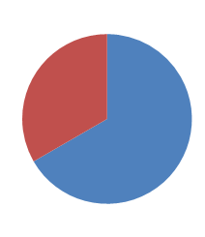
Methods
BB No: 3,297
19,083 EF ≥ 40%
BB yes: 15,786
Propensity score matching 2:1
24,747 EF < 40%
”positive control”
BB No: 2,748
8,244 Matched population
BB Yes: 5,496
Notes:
Our method consists of the prospective Swedish Heart Failure Registry…:
Socioeconomic data which are incredibly important confounders but often lacking in even the most rigorous observational studies
Before 2005: no Dispensed drug registry, agfter 2012, outcomes not yet reported to the Swedish Patient Regsitry
Positive control: We know BB imporve outcomes in HFREF, thus positive control to see how they did in our population

Slide 7
Results
Baseline characteristics:
 | Total cohort
Variable | BB- No n=3,297 | BB- Yes n=15,786 | p
Age | 77±12 | 75±12 | <0.01
Gender, female | 45% | 47% | 0.09
NYHA class |  |  | <0.01
I-II | 64% | 66%
III-IV | 36% | 34%
LVEF |  |  | <0.01
40-49% | 39% | 51%
≥ 50% | 61% | 49%
Creatinine clearance, mL/min | 62±33 | 65±34 | <0.01
NT-proBNP, ng/L | 1,622 (620-3,948) | 2,100 (923-4,569) | 0.04
RAS-antagonist | 68% | 80% | <0.01
Malignancy | 16% | 14% | 0.01
Married / cohabitating | 43% | 46%
Highest education |  |  | 0.07
Compulsory | 52% | 50%
Secondary | 34% | 36%
University | 14% | 14%
Overall cohort: Treated patients: younger, lower EF, higher NT-proBNP, more RAS-antagonist use
Notes:
In the matched cohort, these differences disappeared. So no difference in baseline characteristics

Slide 8
Results
Baseline characteristics:
 | Total cohort |  |  | Matched cohort
Variable | BB- No n=3,297 | BB- Yes n=15,786 | p | BB- No n=2,748 | BB- Yes n=5,496 | p
Age | 77±12 | 75±12 | <0.01 | 78±11 | 78±11 | 0.83
Gender, female | 45% | 47% | 0.09 | 46% | 46% | 0.94
NYHA class |  |  | <0.01 |  |  | <0.01
I-II | 64% | 66% |  | 62% | 65%
III-IV | 36% | 34% |  | 38% | 35%
LVEF |  |  | <0.01 |  |  | 0.60
40-49% | 39% | 51% |  | 41% | 42%
≥ 50% | 61% | 49% |  | 59% | 58%
Creatinine clearance, mL/min | 62±33 | 65±34 | <0.01 | 61±33 | 61±32 | 0.38
NT-proBNP, ng/L | 1,622 (620-3,948) | 2,100 (923-4,569) | 0.04 | 1,920 (773-4,473) | 1,842 (741-4,340) | 0.63
RAS-antagonist | 68% | 80% | <0.01 | 72% | 70% | 0.04
Malignancy | 16% | 14% | 0.01 | 15% | 16% | 0.36
Married / cohabitating | 43% | 46% |  | 44% | 43%
Highest education |  |  | 0.07 |  |  | 0.02
Compulsory | 52% | 50% |  | 51% | 53%
Secondary | 34% | 36% |  | 34% | 35%
University | 14% | 14% |  | 14% | 12%
Overall cohort: Treated patients: younger, lower EF, higher NT-proBNP, more RAS-antagonist use
Matched cohort: small differences
Notes:
In the matched cohort, these differences disappeared. So no difference in baseline characteristics

Slide 9
Results
Propensity score for β-blocker
Propensity scores
Similar
Different
Notes:
And no differecne in PS

Slide 10
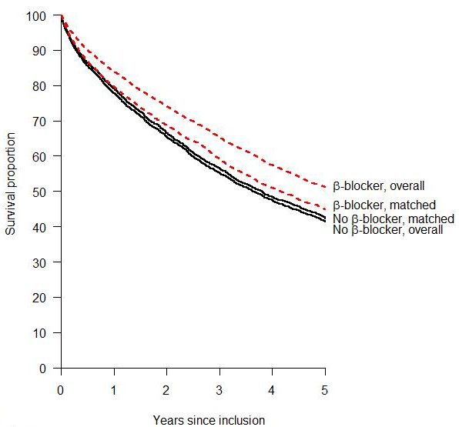
Results
β-blockers associated with reduced mortality in HFpEF
1-year
survival
84%
80%
79%
78%
NNT=100
5-year
survival
51%
45%
42%
41%
NNT=33
Un-adjusted HR:
0.73, p < 0.001
Matched HR:
0.92, p = 0.021
Notes:
These are the main results of the study
In the overall cohort, 1yr survival was in treated patients was 86% and in untreated patients 78%, yielding an un-adjusted HR of 0.73
In the matched cohort, the difference was much smaller, but still significant, with 80% and 79% 1yr survival respectively, yielding a HR of 0.92
Curves separated throughout, but at 1 year the NNT was as many as 100

Slide 11
Results
β-blockers associated with reduced mortality in HFpEF
1-year
survival
84%
80%
79%
78%
NNT=100
5-year
survival
51%
45%
42%
41%
NNT=33
Un-adjusted HR:
0.73, p < 0.001
Matched HR:
0.92, p = 0.021
But β-blockers not associated with reduced combined mortality / HF hospitalization in HFpEF
Notes:
These are the main results of the study
In the overall cohort, 1yr survival was in treated patients was 86% and in untreated patients 78%, yielding an un-adjusted HR of 0.73
In the matched cohort, the difference was much smaller, but still significant, with 80% and 79% 1yr survival respectively, yielding a HR of 0.92
Curves separated throughout, but at 1 year the NNT was as many as 100

Slide 12
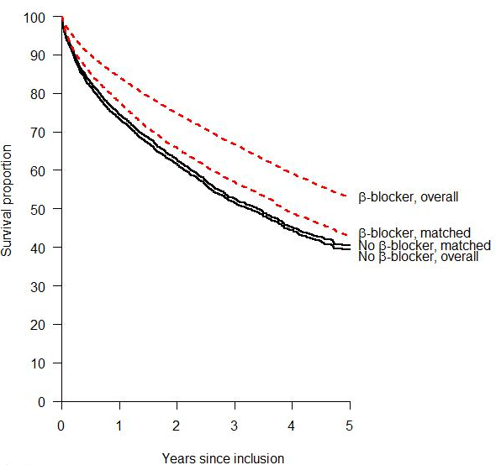
Results
HFrEF positive control:
BB associated with reduced mortality in HFREF:
HR 0.90 in HFREF vs. 0.92 in HFPEF
Matched HR:
0.90, p=0.008
Notes:
HFPEF consistent with HFREF. Thus more likely at true benefit.
In RCTs: HR 0.65 (Brophy, Ann Int Med 2001
Here:
Cross-over, early events, no monitoring, comorbidity

Slide 13
Conclusion
Summary:
β-blockers were associated with reduced all-cause mortality in HFpEF:
HR 0.92 - 8% reduction in all-cause mortality
But not combined all-cause mortality / HF hospitalization
HFrEF positive control:
Similar reduction mortality → lends support to HFPEF findings
Implication:
Adequately powered randomized trial needed in HFpEF
Future Direction:
Registry Randomized Trial
Notes:
Re-hospitalization: 1. not adjudicated and included ICD-10 also for 2nd position: not cause. 2. we have shown that non-CV morb predict hosp, even HF hosp. 3. Older and more comorbidity than in RCTs → more complications → hospitalization. 4. paradoxical nature of re-hosp: see, no diff early.. HF hosp may be INVERSELY realted to moartality (Krumholtz again)
Lower than expected benefit in HFREF: similar reasons. And better in per-protocol.

